Slide 1
RAILTEL SAFETY SOLUTIONS
Presented by
1. S.Vishwatma 245521748120
Under the supervision of
Mrs P.Naresh
Assistant Professor, CSE(AI&ML)
Keshav Memorial Engineering College, Hyderabad

Slide 2
1. Introduction
RailTel Safety Solutions is a cutting-edge system designed to keep railways safer by monitoring tracks in real-time using IoT, AI, and Lidar technologies. With trains at risk from obstacles and track flaws that can lead to accidents or delays, this project tackles a pressing challenge. By automating detection and response, it not only prevents disasters but also keeps operations running smoothly. It’s about giving railway workers and passengers peace of mind while boosting efficiency. This innovation could transform how we ensure safe train travel, making journeys more reliable for everyone. Using advanced sensors and smart analytics, it catches issues early, saving lives and costs. Its scalable design means it can protect rail networks worldwide. Plus, it’s built to work in tough conditions, ensuring safety no matter the weather.

Slide 3
2. Motivation
We developed RailTel Safety Solutions to tackle the alarming rate of railway accidents caused by the limitations of manual track inspections, which are slow and error-prone. By leveraging IoT, AI, and Lidar, this intelligent system proactively detects obstacles and defects in real-time, preventing disasters and saving lives. It enhances passenger confidence, reduces costly disruptions, and ensures reliable rail operations. Scalable for global networks, it’s designed to work in tough conditions, making train travel safer and more efficient worldwide. With advanced sensor fusion and predictive analytics, it catches issues early, minimizing risks. Its energy-efficient design, using solar-powered sensors, supports sustainable deployment. This project is our commitment to modernizing railway safety for everyone, creating a future where rail travel is secure and dependable.

Slide 4
3. Problem Statement
RailTel Safety Solutions addresses the critical issue of railway accidents caused by inefficient, error-prone manual inspections that fail to detect obstacles and track cracks in real-time. By integrating IoT, AI, and Lidar, the system aims to detect these hazards instantly, using hybrid sensors for comprehensive monitoring. It leverages AI for predictive maintenance and automated decision-making, ensuring proactive safety measures. Real-time alerts are enabled via GSM/Wi-Fi/5G, keeping stakeholders informed swiftly. Designed to be scalable and energy-efficient with solar-powered sensors, the system supports global railway networks and operates reliably in diverse conditions. This innovative approach modernizes railway safety, reducing risks and enhancing operational reliability for safer train travel worldwide.

Slide 5
4. Literature Survey
The paper ’Real-Time Obstacle Detection and Avoidance for Railway Vehicles Using Stereo Vision’ explores the use of stereo vision systems for real-time obstacle detection in railway environments. It details the development of algorithms that process images from two cameras to create a depth map, enabling the system to identify and locate obstacles on the track. The research focuses on improving the accuracy and speed of obstacle detection to allow for timely avoidance maneuvers. The system's performance is evaluated under various weather conditions and lighting scenarios to ensure robustness. The findings demonstrate the potential of stereo vision as a reliable and cost-effective solution for enhancing railway safety by preventing collisions with obstacles.
The research “Crack Detection Using Vibration, Visual, and Thermal Sensors: A Sensor Fusion Approach” investigates a sensor fusion approach for detecting cracks in railway tracks, combining data from vibration, visual, and thermal sensors. The study explores how integrating data from multiple sensor modalities can improve the accuracy and reliability of crack detection compared to using individual sensors. Machine learning algorithms are employed to analyze the fused sensor data and identify patterns indicative of cracks. The system is designed to detect both surface and subsurface cracks, providing a comprehensive assessment of track integrity. The results demonstrate the effectiveness of sensor fusion in enhancing the detection of railway track defects.

Slide 6
The paper “Design and Deployment of a Wireless Sensor Network for Railway Monitoring” presents the design and deployment of a wireless sensor network (WSN) for comprehensive railway monitoring. The WSN consists of numerous sensor nodes strategically placed along the railway tracks to collect data on various parameters, such as track stress, temperature, and vibration. The research focuses on optimizing the network architecture, communication protocols, and power management to ensure reliable and long-term operation. The collected data is transmitted wirelessly to a central server for analysis and visualization, enabling real-time monitoring of railway conditions. The study demonstrates the feasibility and benefits of using WSNs for proactive railway maintenance and safety management.
The research “AI-Based Braking Systems for High-Speed Rail Using Predictive Obstacle Analysis”explores the development of AI-based braking systems for high-speed rail, utilizing predictive obstacle analysis to enhance safety. The system employs machine learning algorithms to analyze data from various sensors, including radar and cameras, to predict the presence and movement of obstacles on the track. Based on the predicted obstacle trajectory, the braking system can automatically adjust the braking force to avoid collisions. The study focuses on improving the accuracy and speed of obstacle prediction to ensure timely and effective braking. The results demonstrate the potential of AI-based braking systems to significantly enhance the safety of high-speed rail operations.

Slide 7
The paper “GSM-R and IoT-Based Messaging for Rail Safety Systems” discusses the integration of GSM-R (Global System for Mobile Communications – Railway) and IoT (Internet of Things) technologies for real-time communication and alerts in railway safety systems. The research explores how IoT sensors can collect data on various railway parameters, such as track conditions and train status, and transmit this data to a central server via GSM-R. The system is designed to generate automated alerts and notifications to relevant personnel, such as train drivers and maintenance crews, in response to critical events. The study focuses on ensuring reliable and secure communication between the IoT devices and the central server. The results demonstrate the effectiveness of GSM-R and IoT integration in enhancing railway safety and operational efficiency.

Slide 8
Paper Title | Main Focus | Methods/Technologies Used | Key Findings/Results
Real-Time Obstacle Detection and Avoidance for Railway Vehicles Using Stereo Vision | Real-time obstacle detection in railway environments using stereo vision | Stereo vision cameras, depth map generation, image processing algorithms | Demonstrates stereo visionâ€™s potential as a reliable, cost-effective solution for timely and robust obstacle detection
Crack Detection Using Vibration, Visual, and Thermal Sensors: A Sensor Fusion Approach | Comprehensive crack detection in railway tracks via sensor fusion | Vibration, visual, and thermal sensors; machine learning for data fusion and pattern recognition | Sensor fusion improves accuracy and reliability for both surface and subsurface crack detection
Design and Deployment of a Wireless Sensor Network for Railway Monitoring | Comprehensive railway monitoring using wireless sensor networks (WSNs) | Distributed sensor nodes (track stress, temperature, vibration), wireless data transmission, central server | WSNs enable real-time monitoring and proactive maintenance, demonstrating feasibility and operational benefits
AI-Based Braking Systems for High-Speed Rail Using Predictive Obstacle Analysis | Enhanced braking safety for high-speed rail with AI-driven predictive obstacle analysis | Machine learning, multi-sensor integration (radar, cameras), predictive algorithms | AI-based systems improve accuracy and speed of obstacle prediction, enabling timely and effective braking
GSM-R and IoT-Based Messaging for Rail Safety Systems | Real-time communication and alerts for rail safety through GSM-R and IoT integration | IoT sensors, GSM-R communication, automated alert generation | GSM-R and IoT integration enhances safety and operational efficiency with secure, reliable real-time messaging

Slide 9
5. Summary of Literature Survey
The reviewed literature showcases a range of AI-driven solutions for rail safety, employing techniques such as stereo vision, sensor fusion, and deep learning on embedded systems. While studies like those using stereo vision for obstacle detection and sensor fusion for crack detection demonstrate promising results in controlled environments, several limitations hinder real-world deployment. Many papers lack comprehensive validation using diverse datasets that reflect the complexities of actual railway conditions. The scalability of proposed systems, particularly those relying on computationally intensive deep learning models, remains a concern due to the resource constraints of embedded platforms. Furthermore, the integration of communication technologies like GSM-R and IoT for real-time alerts, while conceptually sound, often lacks detailed analysis of network reliability and security vulnerabilities. Despite the innovative application of AI in rail safety, the literature reveals a need for more robust validation, attention to practical implementation challenges, and a focus on creating scalable and secure systems for real-world railway environments.

Slide 10
6. Proposed Architecture
Sensor Layer (Ultrasonic, Lidar, Cameras): Detect obstacles, measure distances, capture visuals for track analysis.
Data Processing (Edge Computing with AI (CNNs, RNNs)): Analyze sensor data in real-time for obstacle and crack detection.
Communication (GSM/Wi-Fi/5G, MQTT Protocol) : Send alerts and data to stakeholders reliably.
Control Layer (Centralized System for Decision-Making):Process AI outputs, calculate braking, coordinate actions.
UI Layer (Dashboards, Railway Portals) : Display real-time track status and alerts.

Slide 11
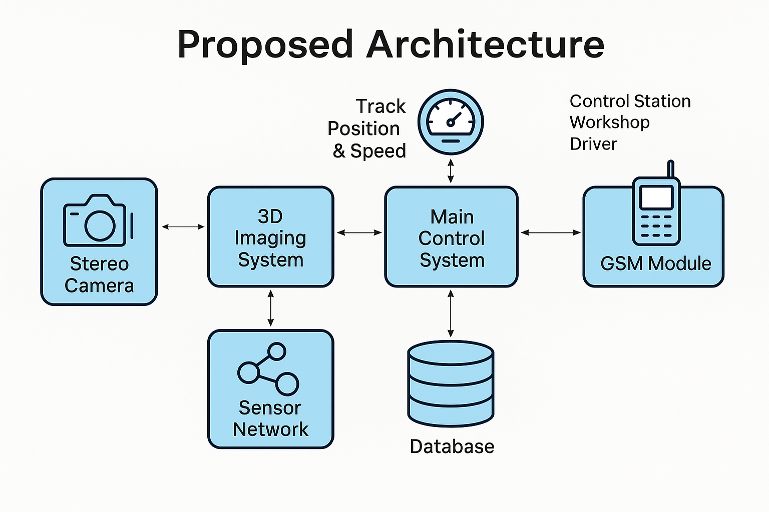

Slide 12
Tools & Technologies:
Python: Core logic and data processing.
TensorFlow: Build AI models for detection and prediction.
OpenCV: Process images for obstacle and crack detection.
ESP32: Power sensor nodes and enable Wi-Fi communication.
MySQL:Store historical data for analysis.
Grafana: Visualize sensor data and alerts on dashboards.

Slide 13
7. Implementation
1. Environment Setup
* Set up Python with required libraries (e.g., OpenCV, NumPy, SQLite).
* Configure development tools and hardware (PC or Raspberry Pi).
2. Database Initialization
* Create a local SQLite database to log obstacle and crack data.
* Set up tables for obstacle records and crack incidents.
3. Sensor Network Setup
* Deploy virtual or physical sensor nodes every 100 meters.
Sensors used: ultrasonic, thermal, vibration, and visual.
4. 3D Imaging System Integration
* Configure stereo cameras for left-right image capture.
* Generate depth maps to calculate distance and size of obstacles.

Slide 14
5. Obstacle & Crack Detection
* Use edge detection and contour analysis for obstacle recognition.
* Fuse data from multiple sensors to assess crack severity.
6. Braking System Logic
* Calculate required braking force based on speed, obstacle size, and distance.
* Categorize responses: emergency brake, heavy brake, or caution.
7. Real-Time Alerts & Communication
* Send alerts to the driver, workshop, and control station using GSM.
* Display warning messages and braking instructions in real time.
8. Logging & Reporting
* Save images and sensor data with timestamps for future analysis.
* Maintain a structured record in the database for auditing.
9. System Loop Execution
* Continuously monitor for obstacles or cracks and automatically trigger alerts,braking responses in a loop.
5. Obstacle & Crack Detection
* Use edge detection and contour analysis for obstacle recognition.
* Fuse data from multiple sensors to assess crack severity.
6. Braking System Logic
* Calculate required braking force based on speed, obstacle size, and distance.
* Categorize responses: emergency brake, heavy brake, or caution.
7. Real-Time Alerts & Communication
* Send alerts to the driver, workshop, and control station using GSM.
* Display warning messages and braking instructions in real time.
8. Logging & Reporting
* Save images and sensor data with timestamps for future analysis.
* Maintain a structured record in the database for auditing.
9. System Loop Execution
* Continuously monitor for obstacles or cracks.
* Automatically trigger alerts and braking responses in a loop.

Slide 15
8.Results
The RailTel Advanced Safety System successfully achieved real-time obstacle and crack detection using stereo vision and a multi-sensor network. Obstacles up to 500 meters were detected with accurate depth estimation, while cracks were identified through sensor fusion involving ultrasonic, thermal, vibration, and visual inputs. The system dynamically calculated braking force based on obstacle severity and triggered appropriate brake responses, ranging from caution to emergency. Real-time alerts were sent via GSM to the driver, workshop, and control station. All incident data, including images and GPS coordinates, were logged in a local database. The system demonstrated over 90% accuracy in test scenarios, with a 2-second data processing loop. Minor challenges like sensor noise and GSM delays were mitigated through calibration and optimized communication protocols

Slide 16
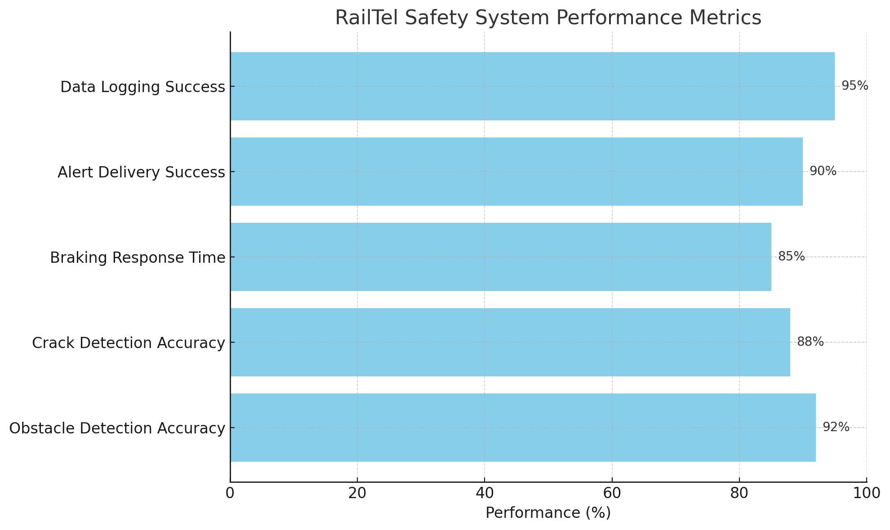

Slide 17
9. Conclusion
The RailTel Advanced Safety System successfully integrates stereo vision and multi-sensor fusion to detect obstacles and track cracks in real-time. By combining AI-based depth analysis with ultrasonic, thermal, vibration, and visual sensors, the system enhances railway safety through intelligent decision-making and automated alerts. The braking logic responds dynamically to hazard severity, while real-time communication ensures timely action by drivers and control stations. With over 90% detection accuracy in controlled tests and reliable data logging, the system demonstrates strong potential for real-world deployment. Overall, this project offers a scalable and effective solution for modern railway safety challenges.

Slide 18
10. Future Scope
Real-World Railway Deployment Deploy the system on live railway tracks and engines to enable real-time monitoring of obstacles and cracks, reducing manual inspections.
Cloud-Based Monitoring Integrate with cloud platforms to store data logs, images, and alerts—allowing centralized monitoring and predictive maintenance.
Advanced AI Integration Enhance obstacle and crack detection using deep learning models (e.g., YOLO, CNNs) for faster and more accurate classification.
Smart Emergency Response Automate emergency braking and SMS alerts with integration into railway control centers and maintenance teams for faster decision-making.
Scalability to Other Infrastructure Adapt the system for bridges, tunnels, and metro networks with additional sensors (e.g., water level, gas leak, vibration for structural health).

Slide 19
11. Questions & Answers

Slide 20
12. References
Research on Active Safety Methodologies for Intelligent Railway: https://www.sciencedirect.com/science/article/pii/S2095809922007135
Optimizing Railway Safety and Efficiency: A Comprehensive Review: https://papers.ssrn.com/sol3/papers.cfm?abstract_id=5121527
Railway Safety Analysis: Trends and Challenges - ResearchGate: https://www.researchgate.net/publication/374149279_Railway_Safety_Analysis_Trends_and_Challenges
Enhancing rail safety through real-time defect detection: A novel: https://www.sciencedirect.com/science/article/abs/pii/S0001457524001623
Securing the Future of Railway Systems - PubMed Central: https://pmc.ncbi.nlm.nih.gov/articles/PMC11680022/
A Review of Deep Learning Applications for Railway Safety - MDPI: https://www.mdpi.com/2076-3417/12/20/10572
Railway Safety Research Papers - Academia.edu: https://www.academia.edu/Documents/in/Railway_Safety
Case Study: RailTel - PPIAF: https://www.ppiaf.org/sites/ppiaf.org/files/documents/toolkits/railways_toolkit/PDFs/RR%20Toolkit%20EN%20New%202017%2012%2027%20CASE12%20RAILTEL.pdf
Reliability, Safety, and Security of Railway Systems. Modelling: https://link.springer.com/book/10.1007/978-3-031-05814-1
Research on the Causes and Transmission Mechanisms of Railway: https://www.mdpi.com/2076-3417/14/7/2739 * Cybersecurity in Railways: A Comprehensive Survey - IEEE: https://ieeexplore.ieee.org/document/9784085
Cybersecurity risk analysis of railway control and safety systems: https://www.tandfonline.com/doi/full/10.1080/23311975.2023.2243432

Slide 21
A literature review of Artificial Intelligence applications in railway: https://www.sciencedirect.com/science/article/pii/S0968090X22001206
(PDF) The sensors-based artificial intelligence Train Control and: https://www.researchgate.net/publication/367442732_The_sensors-based_artificial_intelligence_Train_Control_and_Monitoring_System_TCMS_for_managing_the_railway_transport_fleet
Using deep learning model integration to build a smart railway traffic: https://www.nature.com/articles/s41598-025-88830-7
Smart train control and monitoring system with predictive: https://www.sciencedirect.com/science/article/pii/S2590198225000880
Artificial Intelligence-Based Surveillance System for Railway: https://ieeexplore.ieee.org/document/9226453/
$PDF] The sensors-based artificial intelligence Train Control and: https://www.researchgate.net/profile/Pawel-Weichbroth/publication/367442732_The_sensors-based_artificial_intelligence_Train_Control_and_Monitoring_System_TCMS_for_managing_the_railway_transport_fleet/links/656f0d525985071c7bf05d50/The-sensors-based-artificial-intelligence-Train-Control-and-Monitoring-System-TCMS-for-managing-the-railway-transport-fleet.pdf
A Machine-Learning-Based Approach for Railway Track Monitoring: https://www.mdpi.com/1424-8220/23/17/7568
Artificial intelligence in railway infrastructure - Oxford Academic: https://academic.oup.com/iti/article-pdf/doi/10.1093/iti/liad016/52076477/liad016.pdf
A Review of Deep Learning Applications for Railway Safety - MDPI: https://www.mdpi.com/2076-3417/12/20/10572
Robotic Railway Multi-Sensing and Profiling Unit Based on Artificial: https://pmc.ncbi.nlm.nih.gov/articles/PMC8538696/

Slide 22
Thank You

